Slide 1
Min 30-45: Introduction to Scientific Writing with Overleaf/LaTeX
Learning Objectives (Syllabus):
1) Understand the use of story telling to improve scientific presentations.
2) Know key prerequisites to make your ML project reproducible.
3) Familiarize oneself with tips/tricks in Overleaf document preparation.
4) Integrate an equation, a figure, and a table into a LaTeX document.

Slide 2
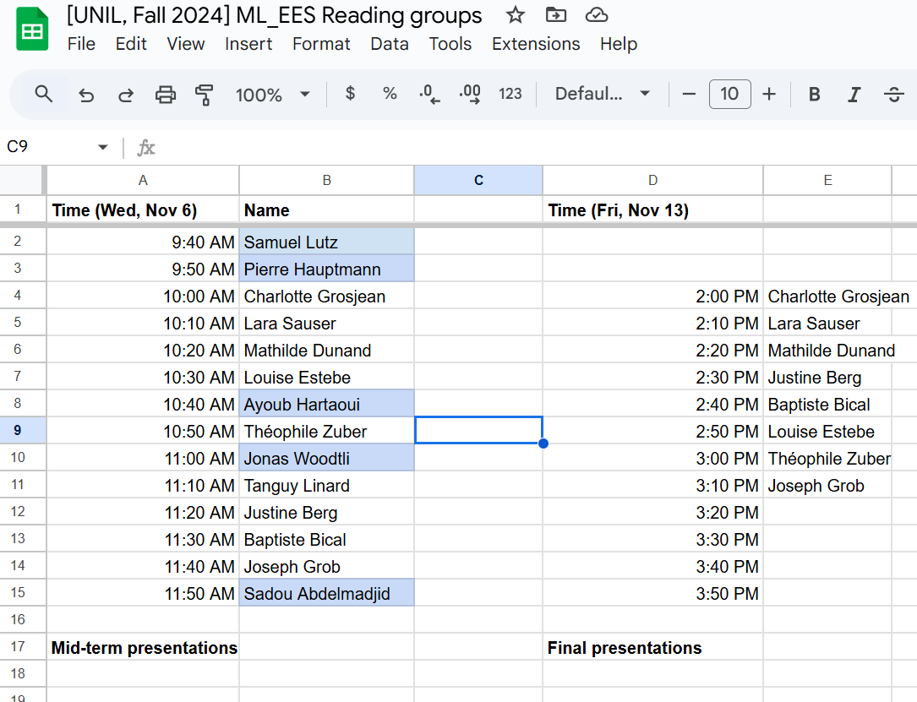

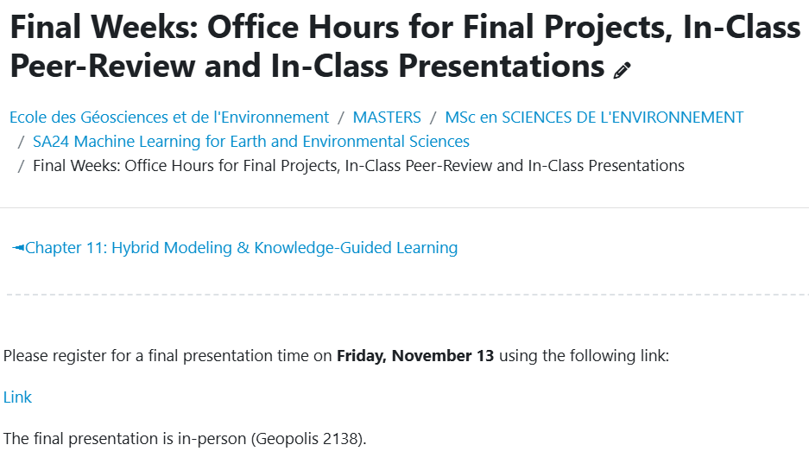
Reminder: Please register for final presentations

Slide 3
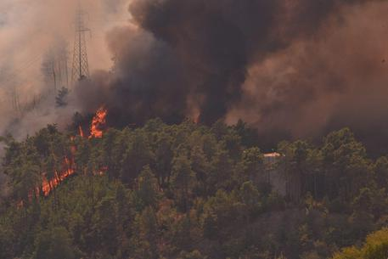
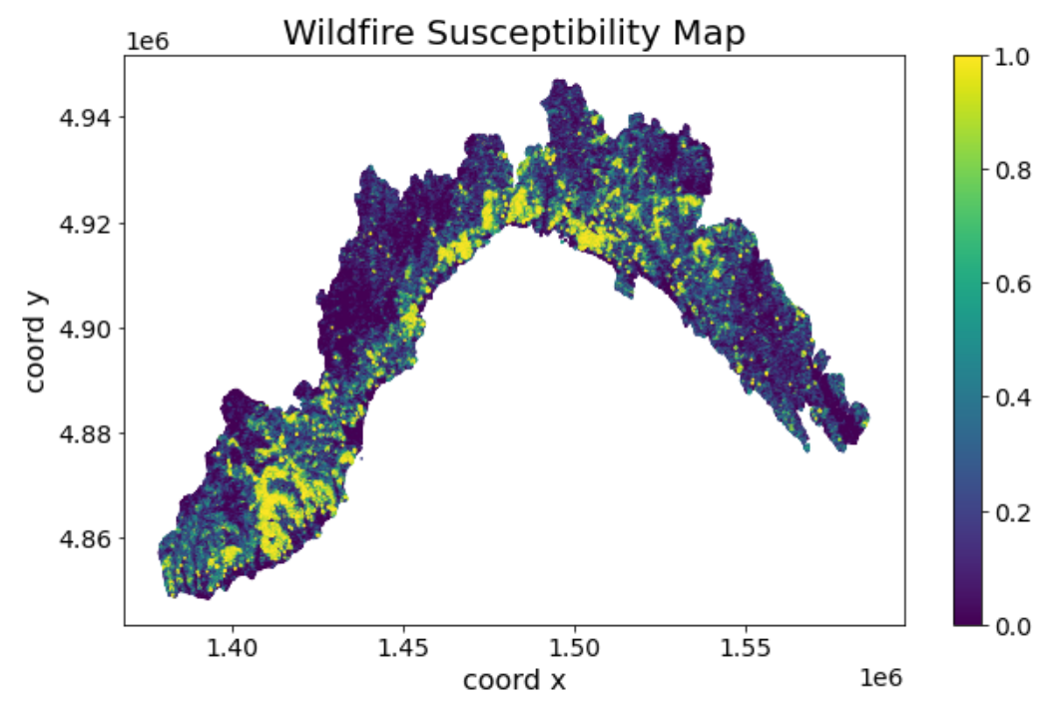

We are using machine learning classifiers to create wildfire susceptibility maps for the Liguria region of Italy. The basic idea is to use ML classifiers to analyze a dataset with observations of weather conditions, vegetation cover, and topography information. The goal is to understand how different factors enhance or reduce the probability of wildfire in Liguria, which can help authorities and decision-makers apply resources to critical areas for hazard prevention. After pre-processing the dataset for classification, we train and benchmark random forests classifiers before making susceptibility maps. After realizing the susceptibility map may be uninformative, we explore its sensitivity to seasons and input selection, realizing it is most informative when made for winter and summer separately and when emphasizing vegetation inputs.
Use active voice for clarity, directness & to highlight ownership of your research.
Source: Trucchia et al. (2022), Tonini et al. (2020), WiKirby
Notes:
Embark on a journey through the Liguria region of Italy, where the battle against wildfires unfolds. In this quest, machine learning classifiers become our steadfast allies, unlocking the secrets hidden within a vast dataset teeming with observations of weather nuances, vegetation cover intricacies, and the contours of the land. Our noble goal? To unravel the intricate dance of factors that either fans the flames or dampens the embers of wildfires in Liguria. Picture this: as the dataset undergoes meticulous pre-processing for classification, we forge ahead, training and benchmarking our random forests classifiers to razor-sharp precision. Yet, an unexpected twist awaits – the susceptibility map, initially lackluster, conceals its true power. Undeterred, we delve into the map's secrets, discovering its heightened sensitivity when tailored to the distinct cadences of winter and summer. The climax? The revelation that emphasizing vegetation inputs transforms the mundane into the extraordinary, paving the way for unparalleled insights into wildfire susceptibility. This scientific odyssey, replete with challenges and triumphs, concludes with a resounding resolution: the power of vegetation inputs, a beacon guiding us toward effective wildfire prevention strategies in Liguria.

Slide 4
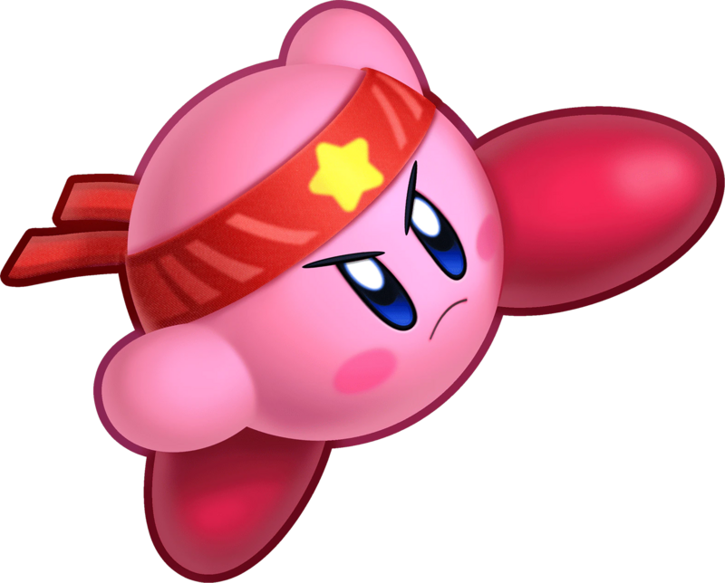

Story telling strategies
Start with scenario building (env. context)
Make your main problem a disruptive element
Create contrast through repeated problems and solutions in a clear structure
Mitigate the conflict through the circumstance changes from your intermediate results
Source: Trucchia et al. (2022), Tonini et al. (2020), WiKirby
Notes:
Embark on a journey through the Liguria region of Italy, where the battle against wildfires unfolds. In this quest, machine learning classifiers become our steadfast allies, unlocking the secrets hidden within a vast dataset teeming with observations of weather nuances, vegetation cover intricacies, and the contours of the land. Our noble goal? To unravel the intricate dance of factors that either fans the flames or dampens the embers of wildfires in Liguria. Picture this: as the dataset undergoes meticulous pre-processing for classification, we forge ahead, training and benchmarking our random forests classifiers to razor-sharp precision. Yet, an unexpected twist awaits – the susceptibility map, initially lackluster, conceals its true power. Undeterred, we delve into the map's secrets, discovering its heightened sensitivity when tailored to the distinct cadences of winter and summer. The climax? The revelation that emphasizing vegetation inputs transforms the mundane into the extraordinary, paving the way for unparalleled insights into wildfire susceptibility. This scientific odyssey, replete with challenges and triumphs, concludes with a resounding resolution: the power of vegetation inputs, a beacon guiding us toward effective wildfire prevention strategies in Liguria.

Slide 5
Tip: Pick an outline inspired by your mid-term presentation
Scientific question: What’s our goal and why do we care?
Dataset: Characteristics, challenges, training/validation/test split, etc.
Methodology: Which ML algorithm(s) are you planning to use and why?
Results: What are your initial results & what do you plan to do next?

Slide 6
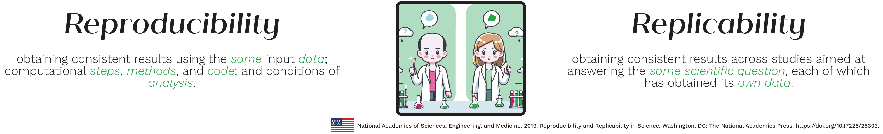
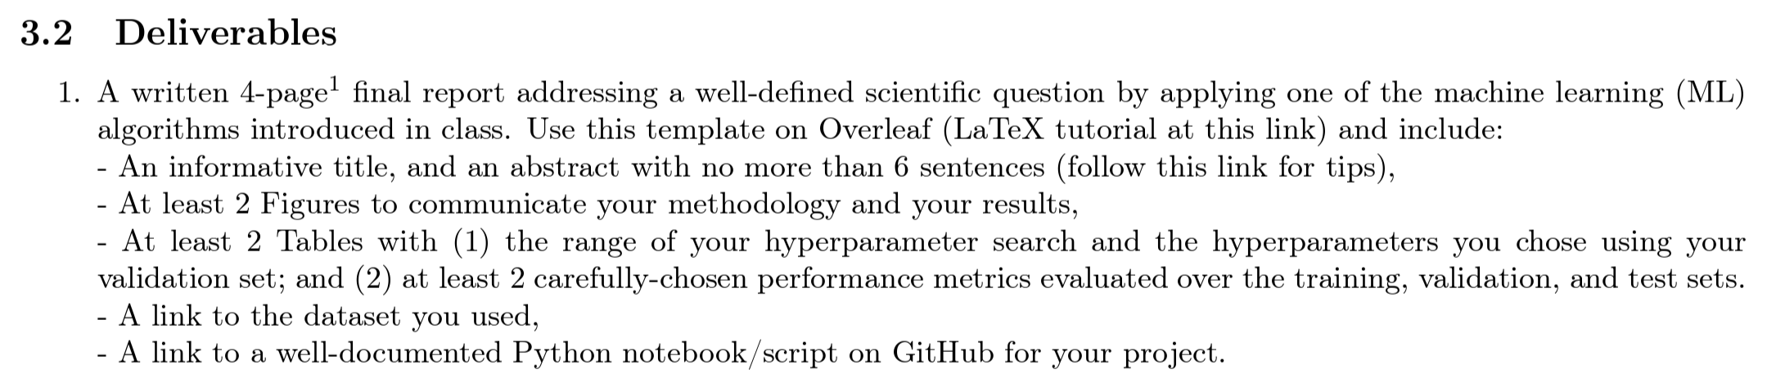
Imagine you were opening another students’ project How would you replicate/reproduce it?

Slide 7

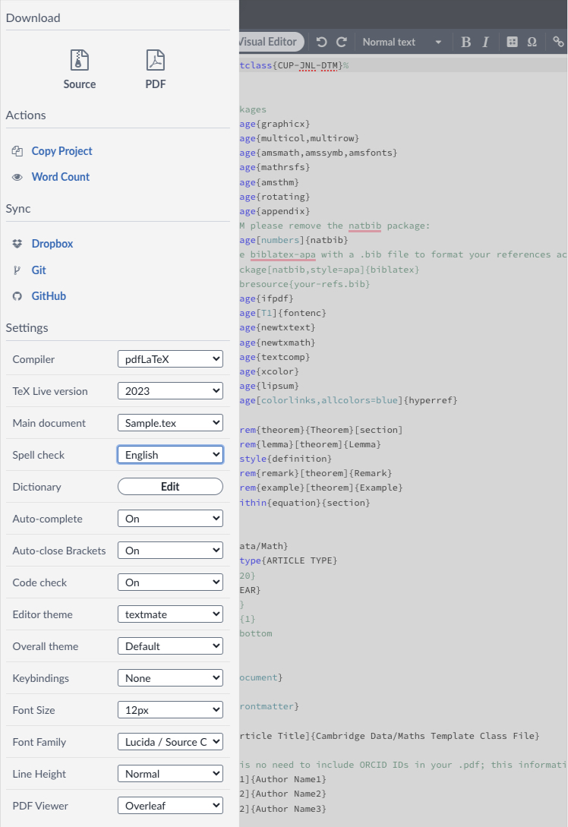
Overleaf tips & tricks
Overleaf has tons of templates to jump start your project → Moodle
Make less mistakes in your writing with spell check

Slide 8
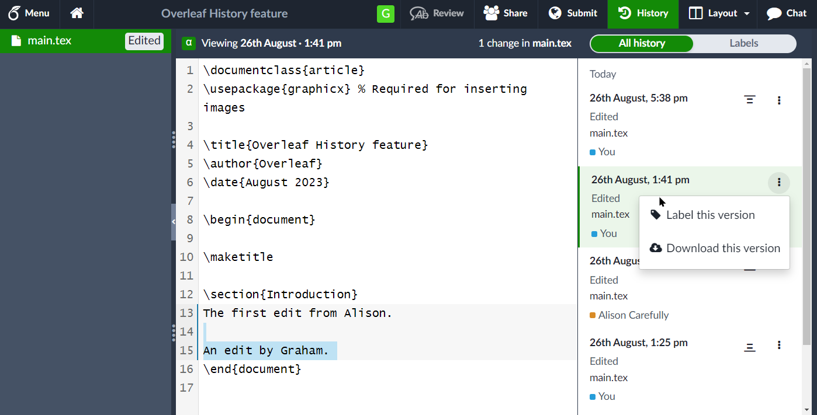
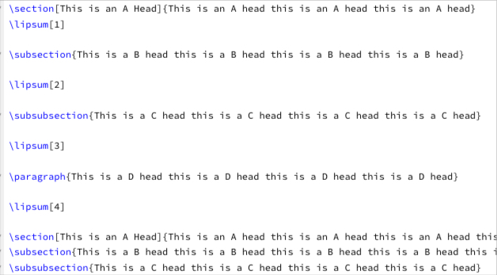
Overleaf tips & tricks
Use the history option to retrieve old version of your document
You should use templates because LaTeX code is nicely prefilled for you!

Slide 9
LaTeX basics
https://www.overleaf.com/latex/templates/cup-data-template/kwrskzvmfxbq (sample template)
We will learn how to:
1) Insert a figure in your report
2) Insert a table in your report
3) Write some equations in your LaTeX document

Slide 10
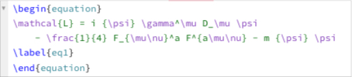
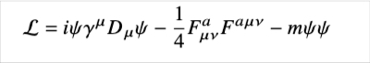
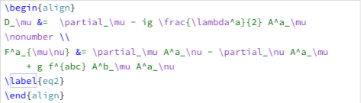
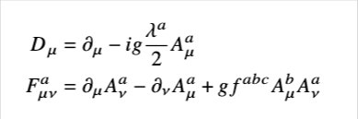
Integrate equations
Compile
Compile

Slide 11
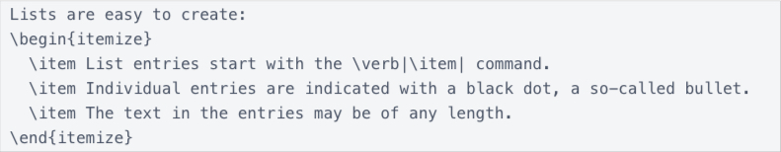
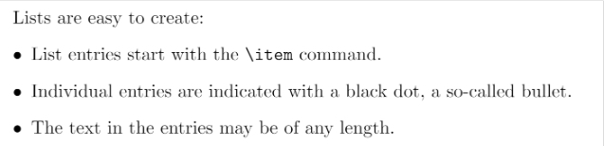
Use similar code to create lists
Compile
Substitute itemize with enumerate and see what happens!

Slide 12
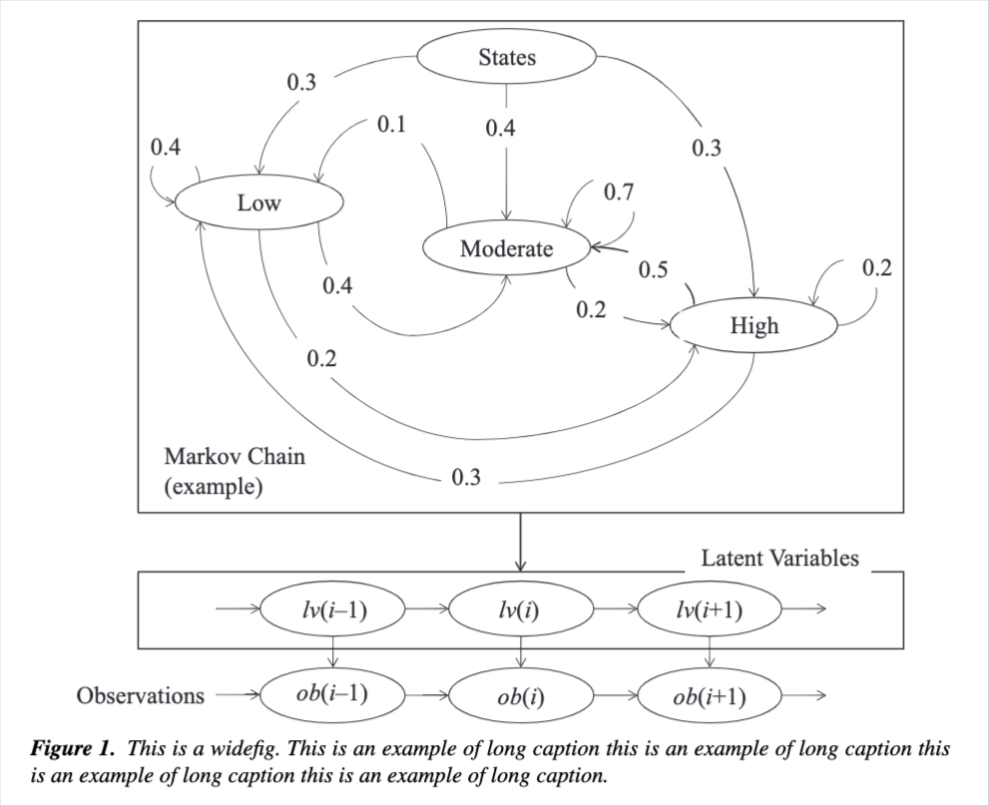
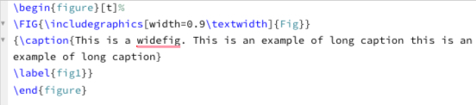
Add a figure to the LaTeX document
What would happen if you change the 0.9 to something else?

Slide 13
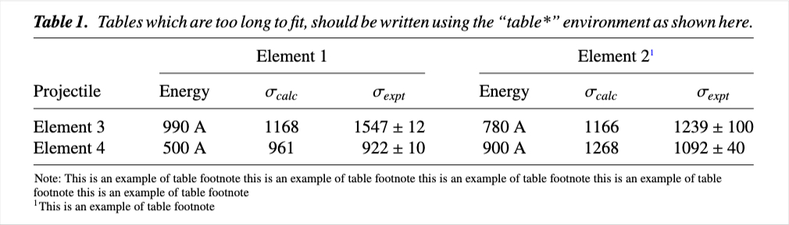
Add a table to your report
Which part of the code produces this table? It's complex!

Slide 14
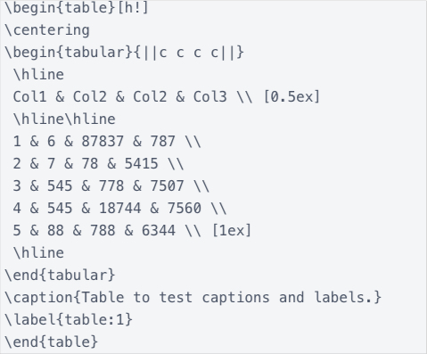
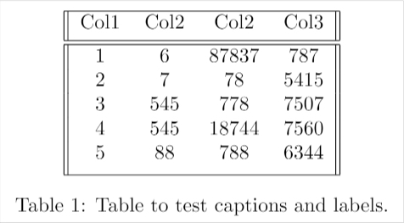
Add a table to your report
https://www.tablesgenerator.com/ More information: https://www.overleaf.com/learn/latex/Tables

